Slide 1
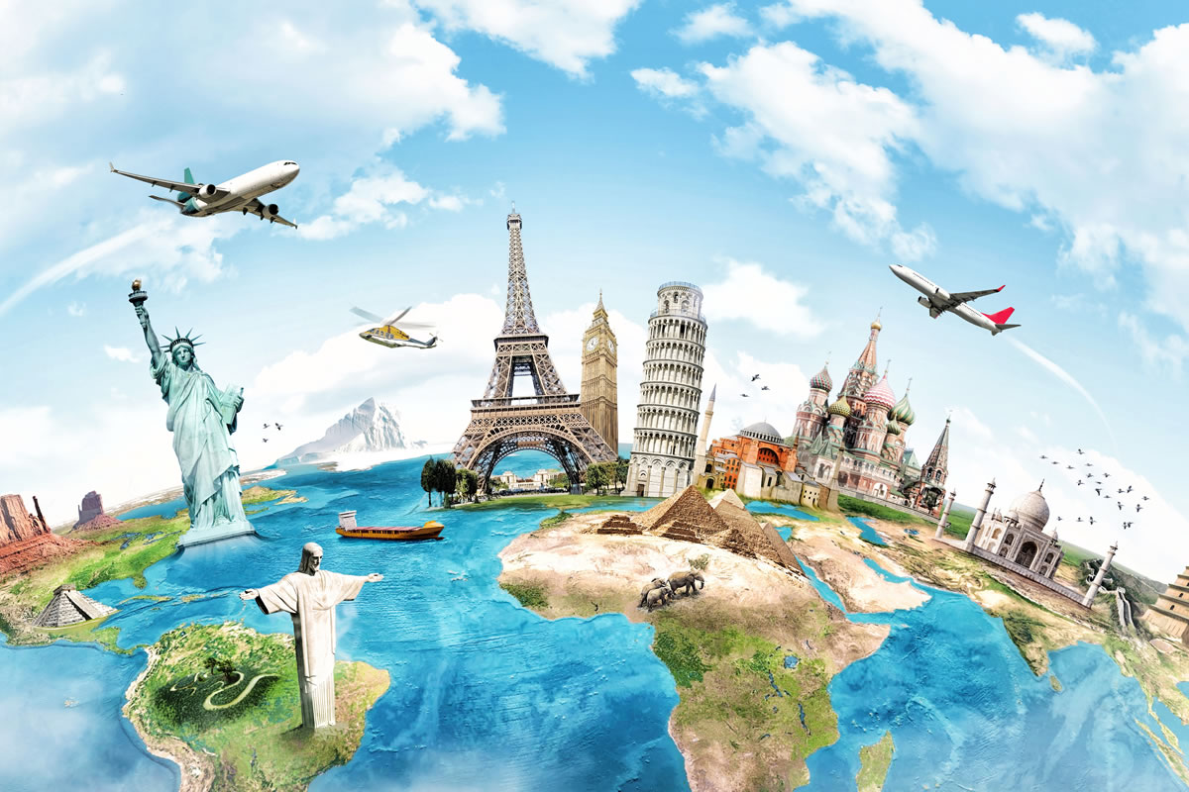

Globetrotter
CS6392019
07/11/2019
Te Yi Tsai And Sukhada Sheth

Slide 2
Problem Description
Everyone loves to travel.
Travelling is not just about visiting places, it is a systematic process.
We research about the destinations, make detailed itinerary, we set up our budget, we click pictures, maintain a diary, keep track of the expenses etc.
There exist various applications online to achieve each of the above tasks.
But it becomes difficult to maintain information on various applications and every application has different look and feel.
It is tedious to get all the information about one travel experience as one would have to check all the applications and try to correlate information from all the applications.

Slide 3
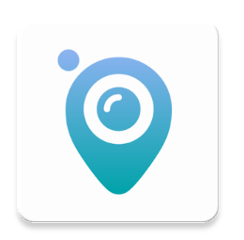
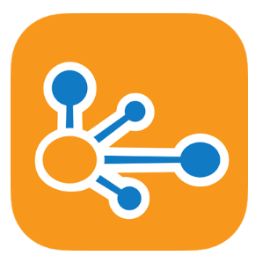

Research
Travel Journal
https://play.google.com/store/apps/details?id=com.journiapp.journi
TripIt
https://play.google.com/store/apps/details?id=com.tripit
Splitwise
https://play.google.com/store/apps/details?id=com.Splitwise.SplitwiseMobile

Slide 4
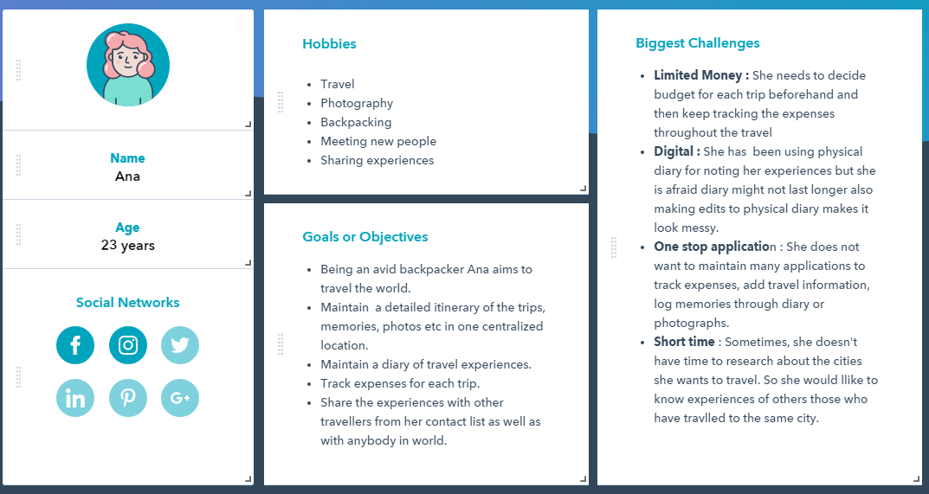

Slide 5
Features of the application
Where I have been map and index(Cardview)
Add Checklist
Add the travel details
Add and Track expenses
Maintain a detailed diary of each travel
Get local news of city
Share diary

Slide 6
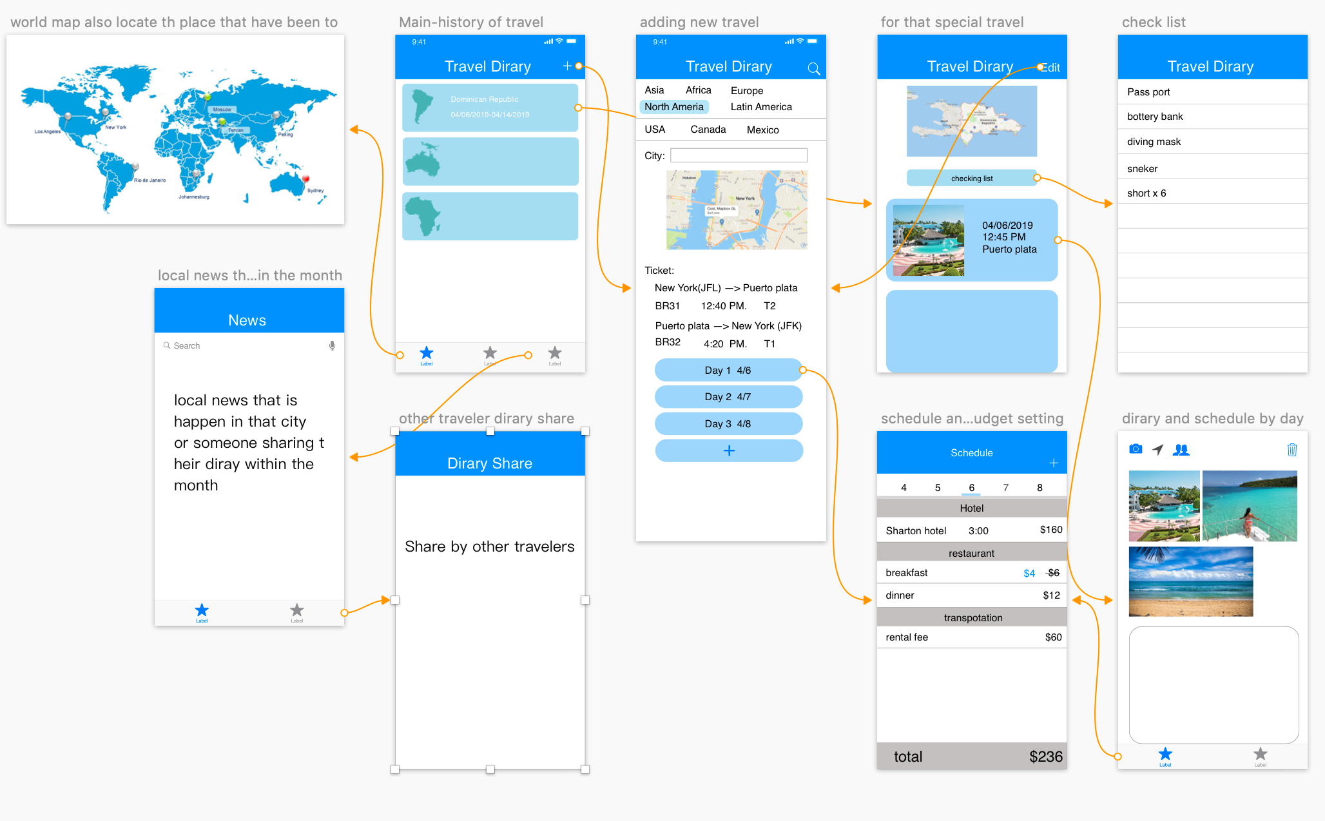

Slide 7
Technology Used
Android Min SDK 24 and Max SDK 28
Android Studio
Firebase Authentication
Material Design
Firebase Realtime Database
SQLite

Slide 8


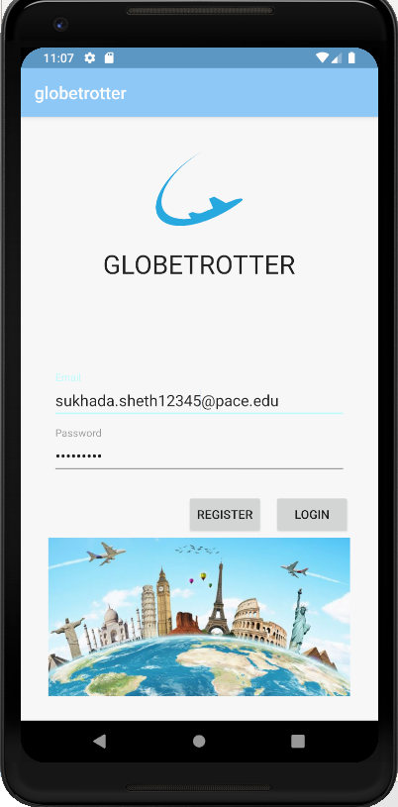
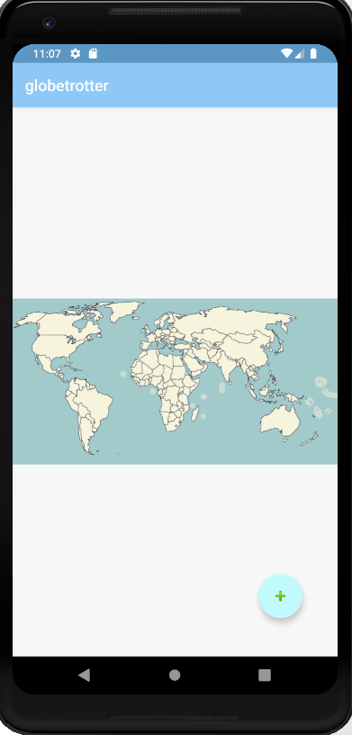
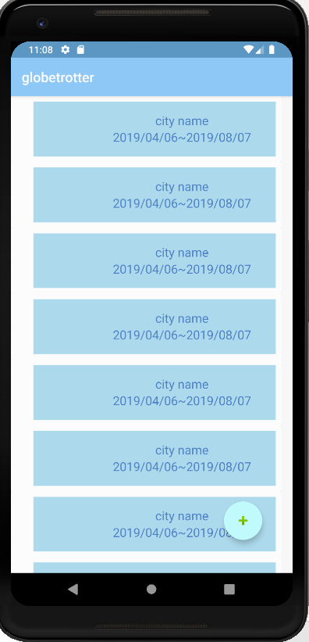
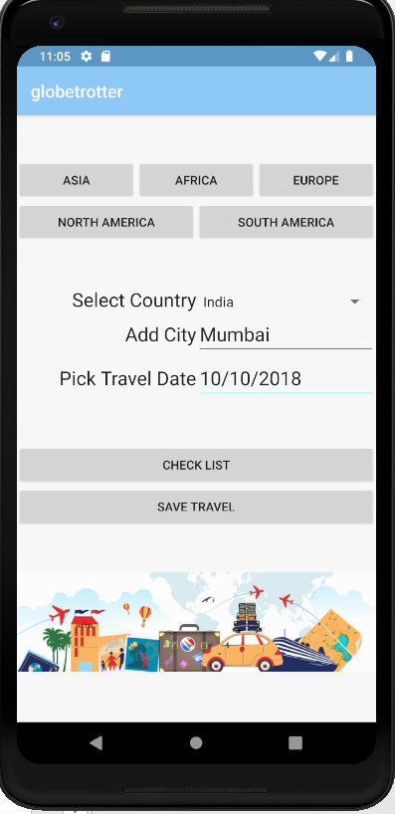
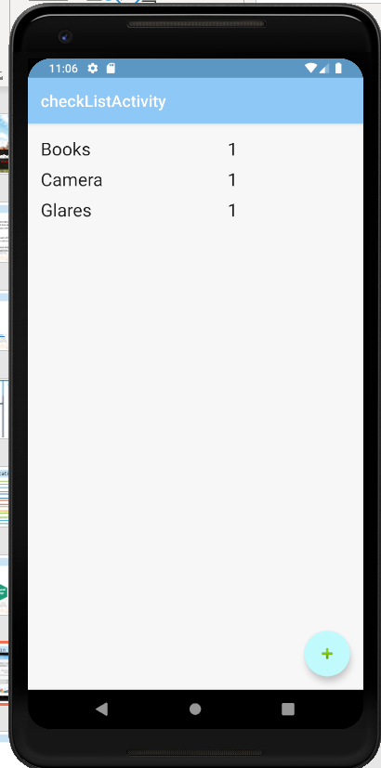
Look of the Application

Slide 9
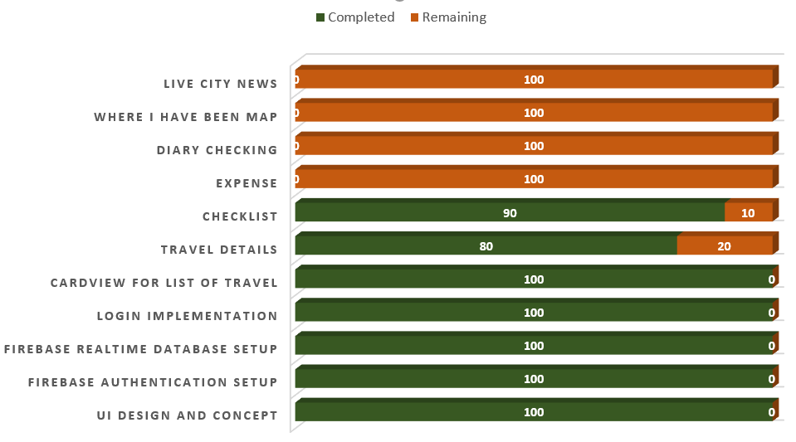

Development Status

Slide 10

Problem Encountered during Development

Slide 11


